Slide 1
3.2 Deployment and Monitoring
POSGRAD
MNA

Slide 2
CI/CD for ML.

Slide 3
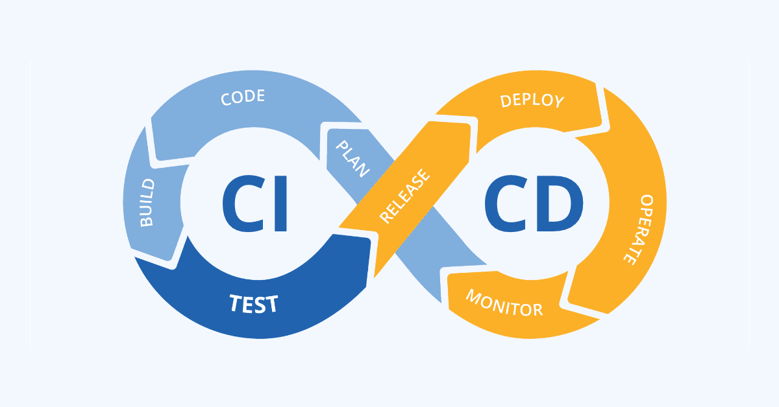
Introduction
Developing and releasing code to production environments is crucial to software development. To support this, DevOps was established, incorporating CI/CD to enable more frequent changes through the automation of development processes.

Slide 4
What is CI/CD?
A CI/CD pipeline consists of a series of automated, consecutive steps that support the integration and deployment of small changes to an active application.
Typically initiated by a new commit to the version control system, CI/CD pipelines steer modifications through multiple stages until they are securely deployed to the production environment.
From the initial code commit to production deployment, the code is subjected to processes such as:
Unit testing, linting, and security checks.
Conversion into binaries or container images.
Deployment to a staging environment for comprehensive testing.

Slide 5
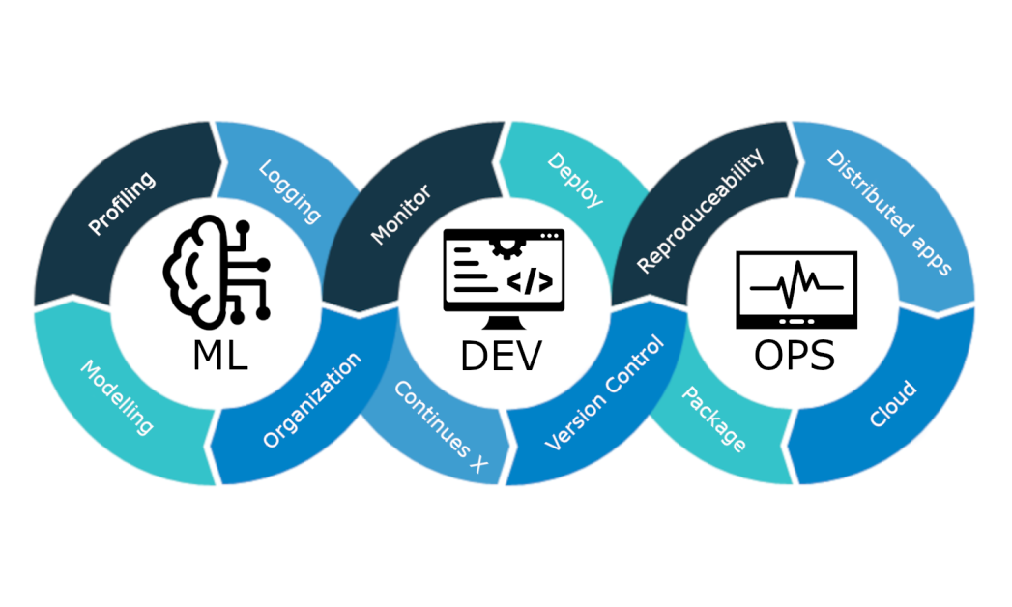
Could this work for ML Pipelines?
Essentially, the main motivation for automating these processes lies in the vulnerability of ML models to performance deterioration. This necessitates periodic retraining with updated data and redeployment, mainly due to the two added dimensions brought by ML
Model
Data

Slide 6
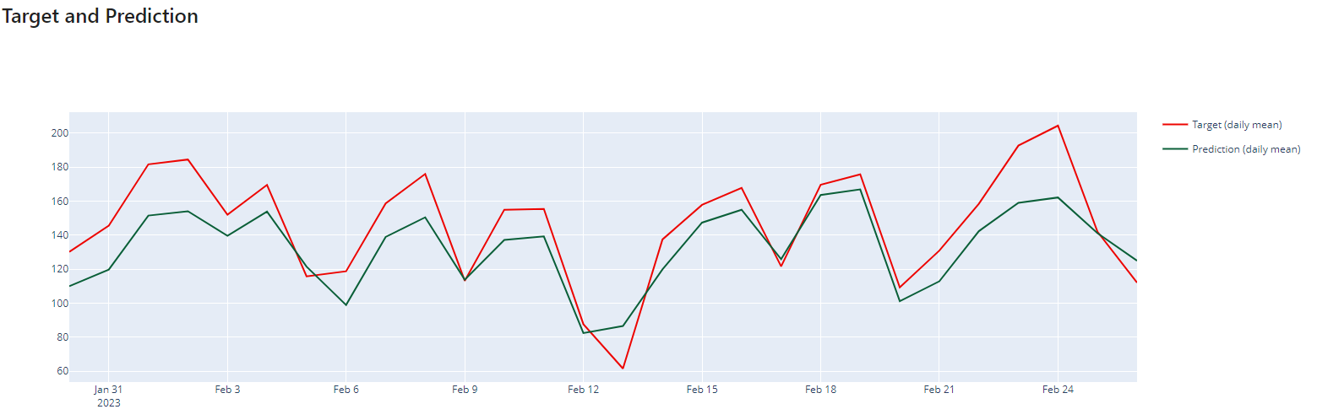
Challenges to achieve this.
Key challenges inherent to developing ML pipelines include:
Storing model artifacts and facilitating experiment tracking for comparison and reproducibility of results.
Managing extensive and fast-evolving datasets.
Beyond monitoring model performance, ML requires continuous attention to data changes and adapting models as needed.

Slide 7
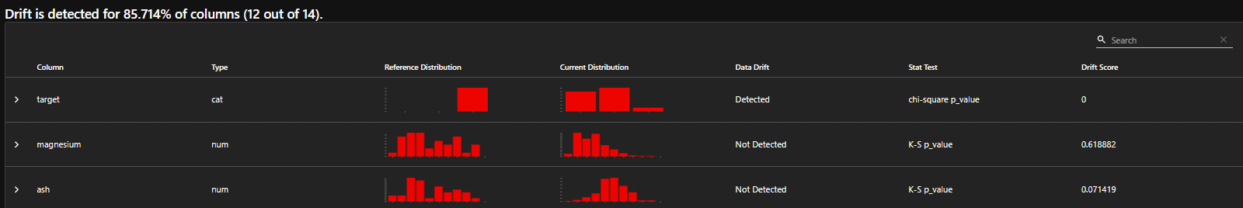
ML systems require ongoing monitoring to detect performance and data drift. If model accuracy falls beneath a defined threshold or concept drift occurs, the system must go through a new cycle. This involves repeating every step, including data validation, model training and evaluation, testing, and deployment.

Slide 8
Continuous Integration in ML.

Slide 9
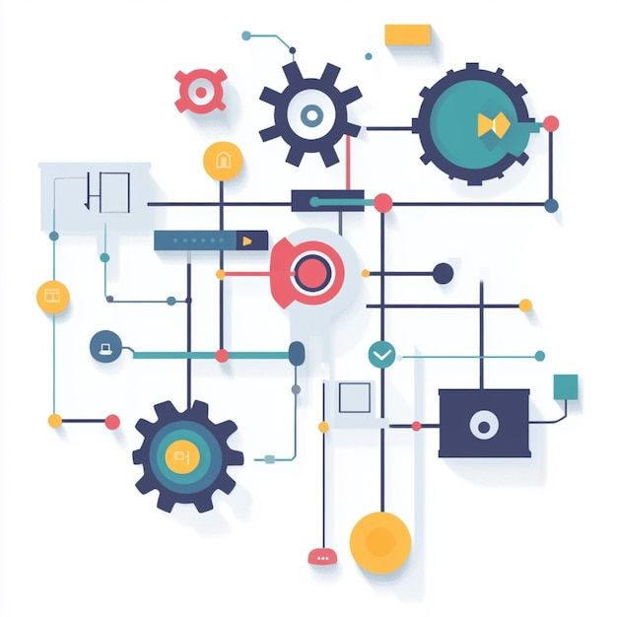
The main objective of Continuous Integration (CI) in ML is to maintain code quality and functionality, preparing the codebase for the following stages of the ML lifecycle. The separation of model training and evaluation is essential for several reasons:
Complexity and resource demands: Model training often requires significant computational power, making it impractical to include within the CI phase, as it could disrupt the efficiency of the code integration process.
Separation of concerns: Isolating the model training phase from the integration process enhances the flexibility of the development workflow
Notes:
Complexity and resource reqs:

Slide 10
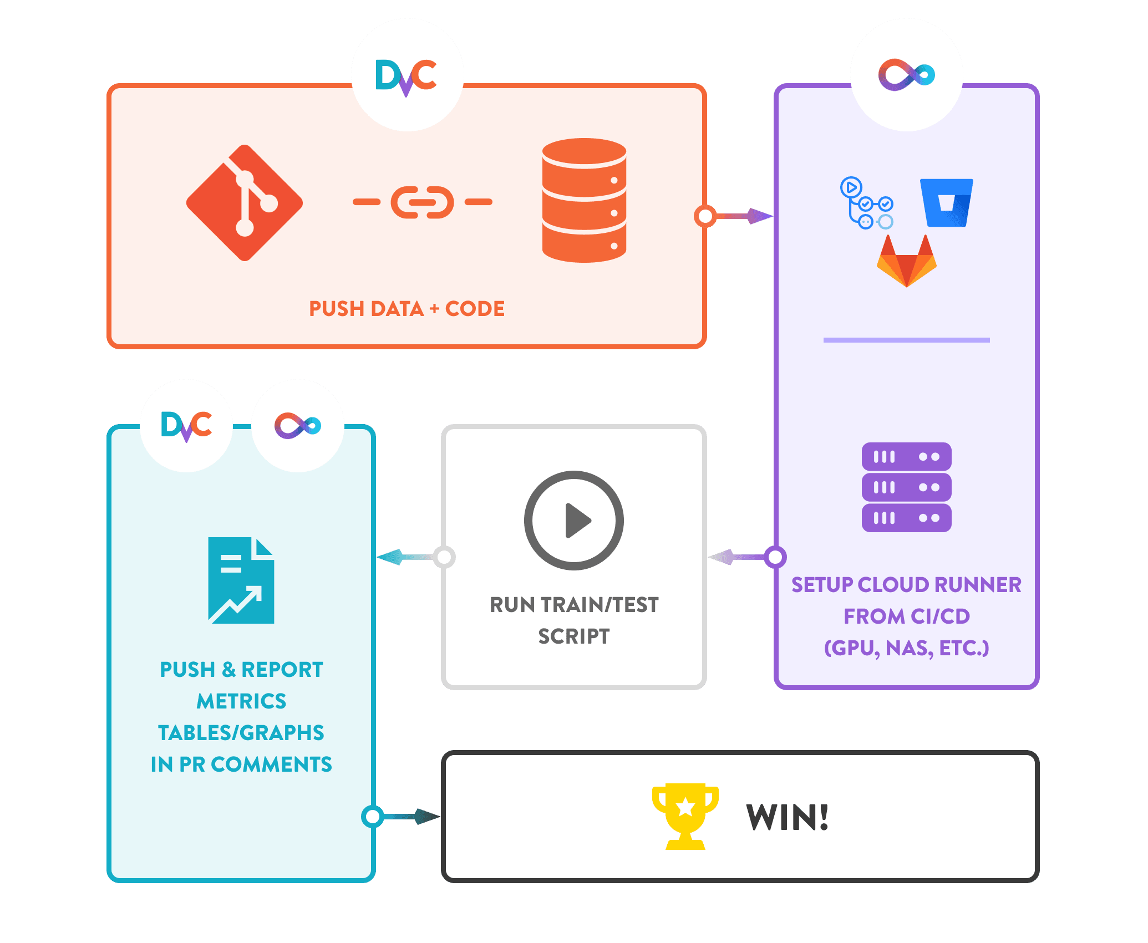
The iterative nature of ML development: Model training is fundamentally iterative, involving numerous experimental cycles. Including these iterative training phases within the CI workflow would significantly slow the process.
The primary result of the CI phase in ML is a packaged model code fully prepared for deployment in either a prediction-serving or training environment.
Notes:
Complexity and resource reqs:

Slide 11
Tools for Continuous Integration (CI) development.
GitHub Actions:
Primarily, it provides the benefit of being integrated within the same ecosystem as your code, eliminating the need to switch platforms. It is an effective tool for automating the processes of building, testing, and deploying.
CircleCI:
This platform is known for its simplicity in use and setup, making it ideal for teams seeking a straightforward, cloud-based CI solution.
Jenkins:
It stands out for its extensive customization and control, making it the go-to option for projects that require testing on local hardware or highly configured cloud services.

Slide 12
Continuous Training in ML.

Slide 13
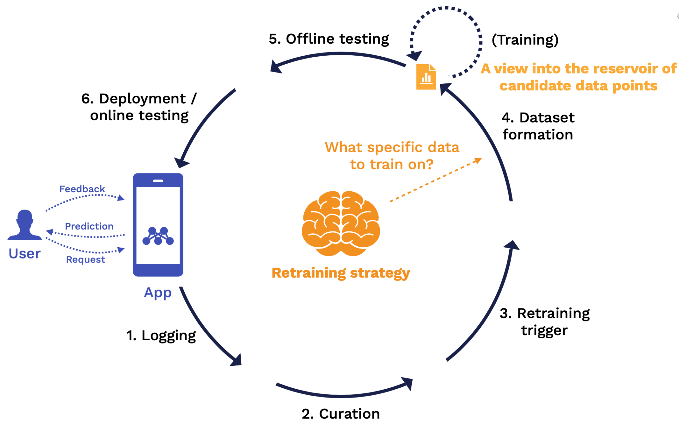
What is it?
Continuous Training (CT) is an essential element of the ML lifecycle, centered on the continuous automation of training and retraining ML models in the pipeline. This ensures models remain relevant and effective as data evolves and environments change.
Unlike a single training phase, CT allows models to adapt over time by learning from new data and maintaining or enhancing their performance. This is particularly evident in applications where data patterns shift frequently, such as recommendation systems, fraud detection, or predictive maintenance.

Slide 14
Tools for CT.
Kubernetes with Kubeflow:
This combination provides a robust foundation for scalable and efficient container orchestration. With Kubeflow, it forms a powerful setup for ML pipelines, enabling teams to execute training jobs seamlessly across a multi-node cluster.
Amazon SageMaker:
A fully managed, end-to-end platform that simplifies the process of building, training, and deploying ML pipelines.
Google Vertex AI:
Integrates multiple GCP ML services, streamlining the management of the ML lifecycle.
Qwak:
Allows you to train and convert your model code into a deployable artifact, starting from your local machine or GitHub repository

Slide 15
Continuous Deployment in ML.

Slide 16
What is it?
Continuous Deployment (CD) in ML refers to the automated process of deploying ML models to production once they have been trained and validated. This practice ensures that the system consistently operates with the most current and effective model, enhancing overall efficiency and performance.
Initially, the pipeline is deployed to a staging or shadow environment, which mirrors the production setup as closely as possible. This phase allows for model validation in a controlled and secure setting, providing insight into how the model would function in a live environment

Slide 17
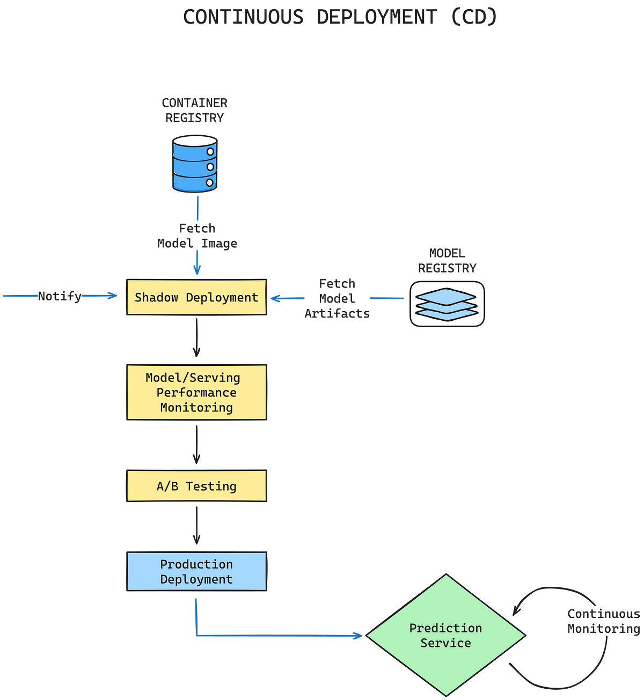

Slide 18
Monitoring and evaluation.

Slide 19
What is it?
After deployment to the staging environment, the model's performance is closely monitored. This involves tracking critical metrics such as accuracy and latency, as well as specific business KPIs.
Monitoring during this stage is essential to ensure that the model functions as intended before it affects actual users.
Adhering to the CI/CT/CD process guarantees efficient deployment and sustains long-term operational effectiveness. Continuous performance monitoring and drift detection enable prompt reactions to changes in data or model behavior.

Slide 20
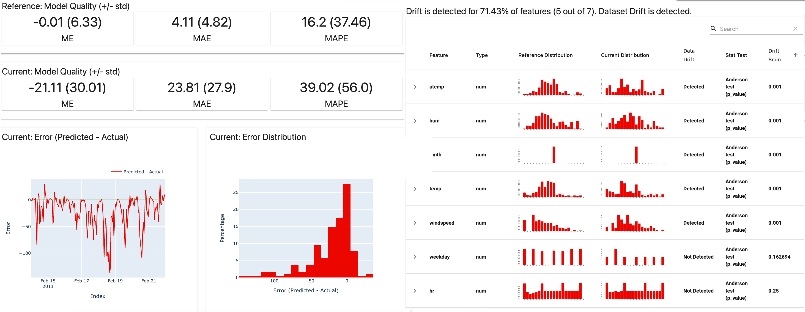

Slide 21
Drifting.

Slide 22
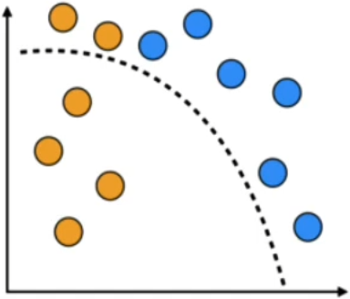
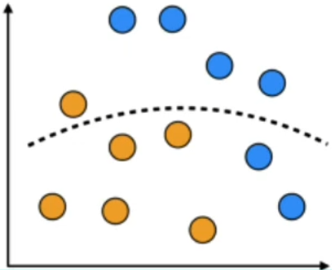
The world is dynamic, and a model usually creates a static model from historical data. Once the model is in production, it can begin to degrade, making increasingly unreliable predictions.
Concept drift and data drift are two main reasons why models degrade over time.

Slide 23
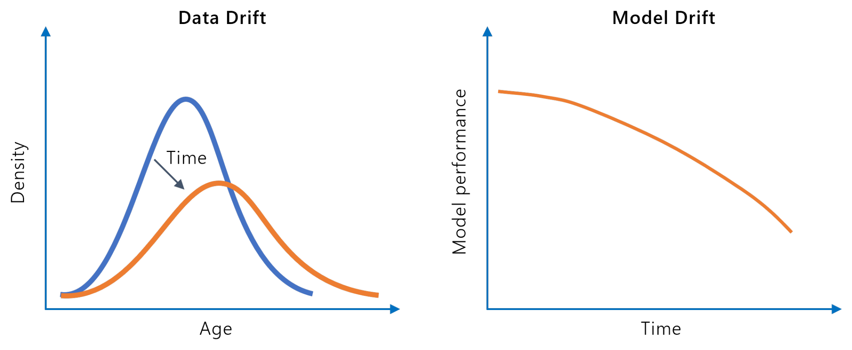
Data drift
Any changes in the input data compared to the data used for training.

Slide 24

Data Drift, what is it?
Occurs when input data distribution deviates in time with respect to the data used to train the model.
As a consequence, the accuracy of the trained model decays.
It is a common and important problem that needs to be considered when deploying models.
https://www.evidentlyai.com/ml-in-production/data-drift

Slide 25
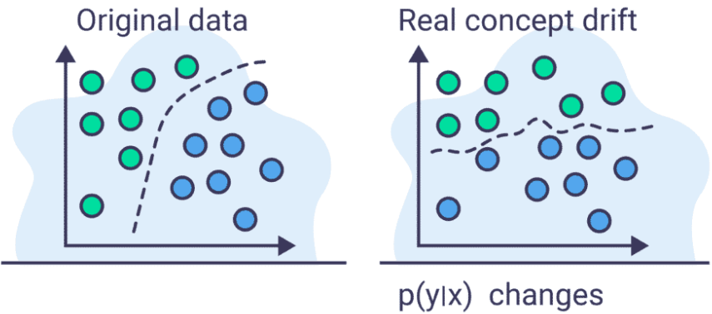
Concept drift
It occurs when reality/behavior changes the relationship between the input x and the target y. This usually occurs because the concepts governing the model have changed.

Slide 26
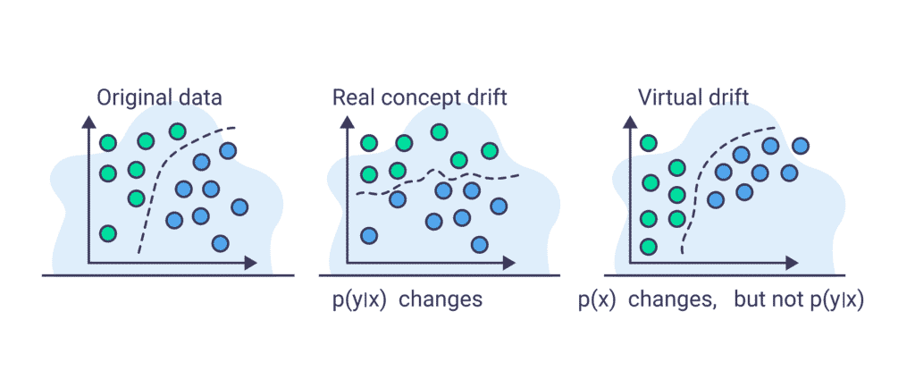
Concept Drift vs Virtual Drift
It implies that the performance of the model has changed.
There is a change in the distribution of the characteristics, but the model performance has not changed. I.e. Change in data collection method or drift in sensors
Notes:
probabilidad condicional, y dado x

Slide 27
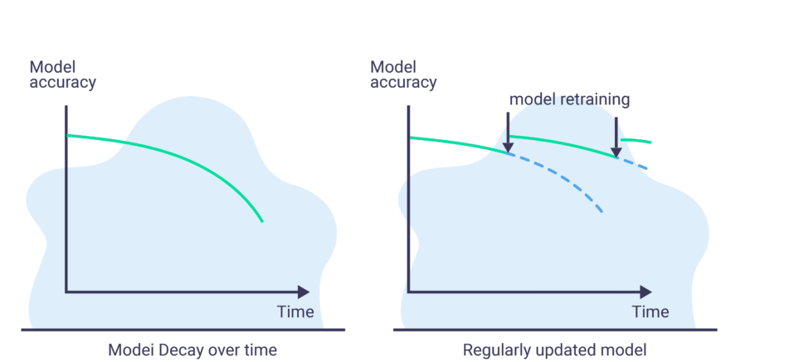
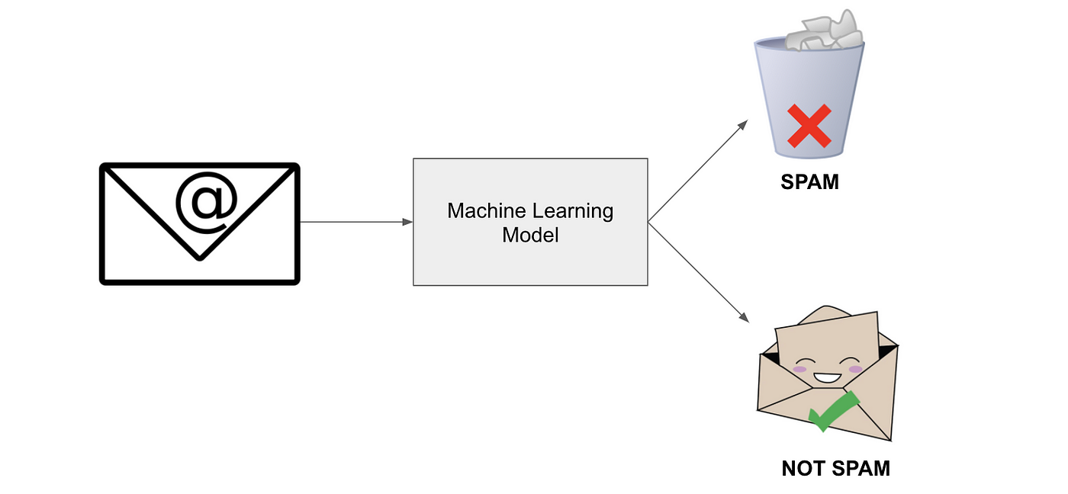
How to handle Data Drift in real life?
Measure the precision of the model using some metric.
Trigger the retraining of the model according to some rule.

Slide 28
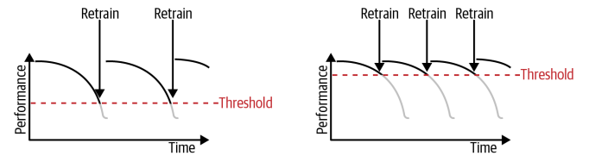
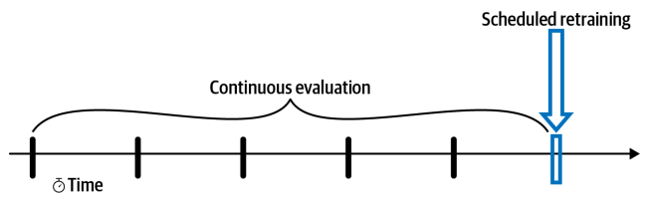
Model’s Continuous Evaluation - Triggers
Set a trigger with a high-performance threshold guarantees a higher quality model in production.
It may as a consequence, require more often replacement or retraining compared to lower threshold models.
It is a trade-off.

Slide 29
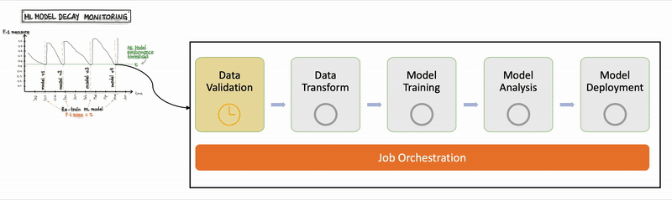
How to continuously evaluate and monitor methods?

Slide 30
Handling Data Drift
Once the model has been deployed:
It needs to be constantly monitored.
There are tests to detect the cause of the changes.
It must be determined, according to the application, when it is required to replace/retrain a model.
CI/CD pipelines automate the model training/testing/re-deployment.

Slide 31
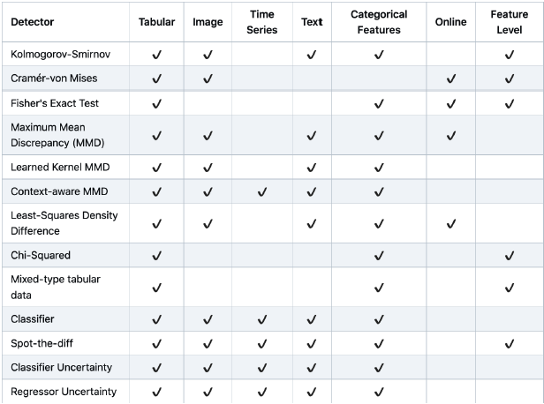
Some Data Drift Detection Methods
https://github.com/SeldonIO/alibi-detect

Slide 32
Other types of Drift
Prediction Drift
Training-serving skew (Domain shift)
https://www.evidentlyai.com/ml-in-production/data-drift

Slide 33
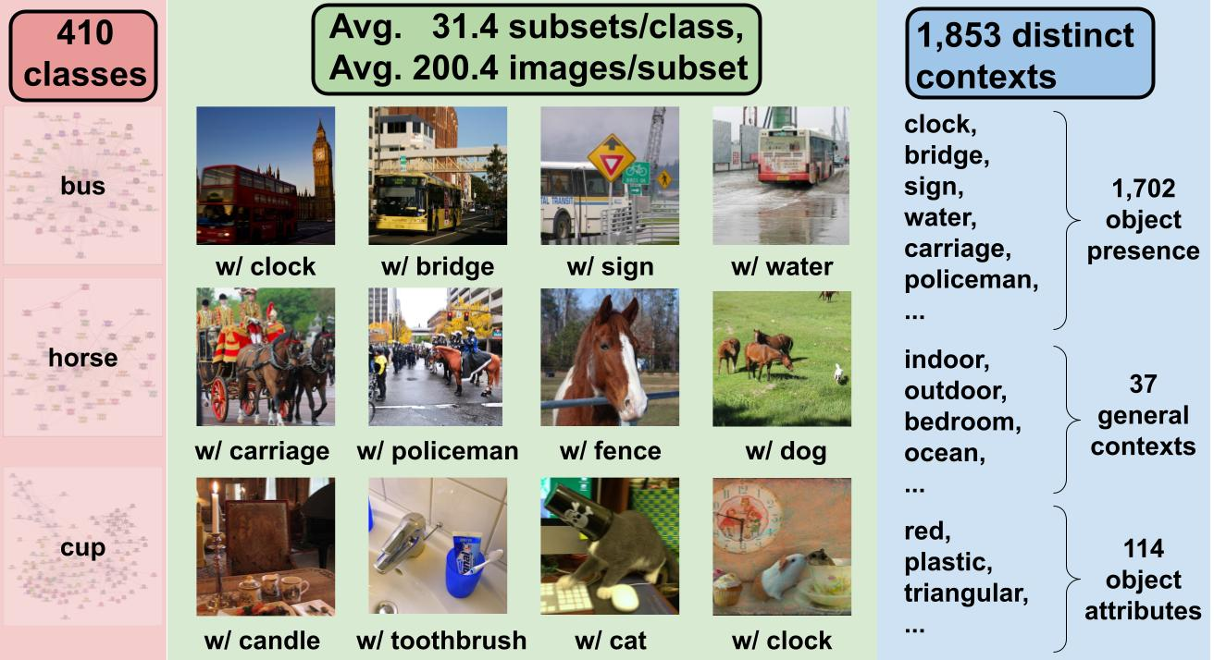
Metashift for testing Domain Shift
https://metashift.readthedocs.io/en/latest/index.html

Slide 34
References.

Slide 35
For further reference:
Continuous Delivery for Machine Learning
MLOps journey: Building a mature ML development process
MLOps tools platfotms landscape
Evidently tutorial
Model monitor. Evaluating, comparing and monitoring models

